Slide 1
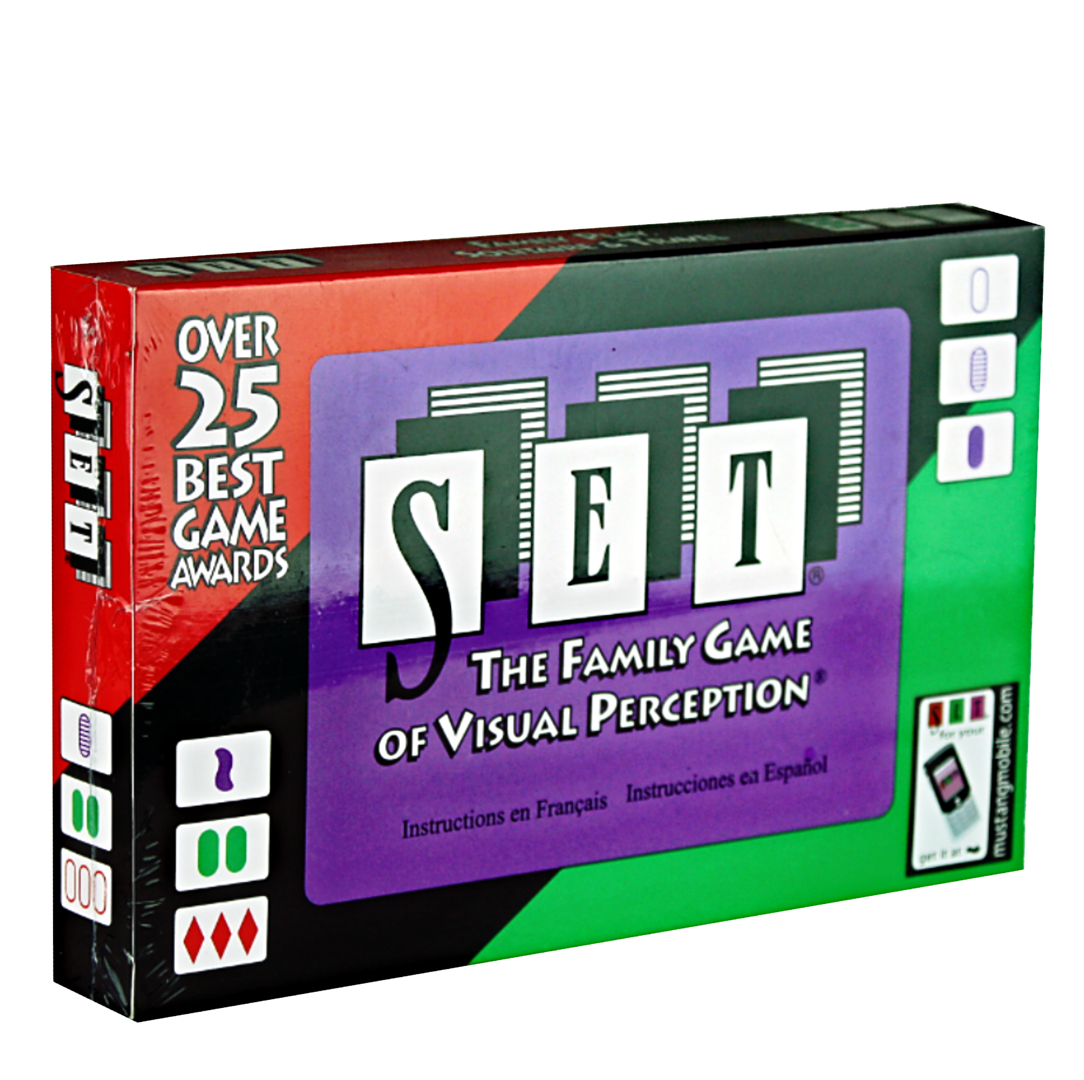
SET: An Algorithmic Approach
Leonardo Amabile
Jacopo Omodei

Slide 2
Outline
01
02
03
04
Dataset generation
Statistical evaluation
The game of SET
Generating tables and counting SETs using our algorithm
Probability of SETs
Analytical approximations
Neural network
Successful model
Different architectures
A counting problem
Final model and results
Discussion and questions

Slide 3
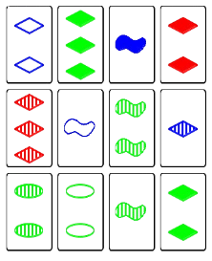
The game
Each card has 4 attributes, and each attribute can have 3 different flavors
Color, shape, shading, and number
3^{N_attributes} (81) unique cards, a table consists of 12 random cards.
Various ways to make a SET of 3 cards:
Each attribute must have three same flavors or three different flavors.
Example 1: different colors, different shapes, different shadings, different number
Example 2: same color, different shapes, different shadings, different numbers

Slide 4
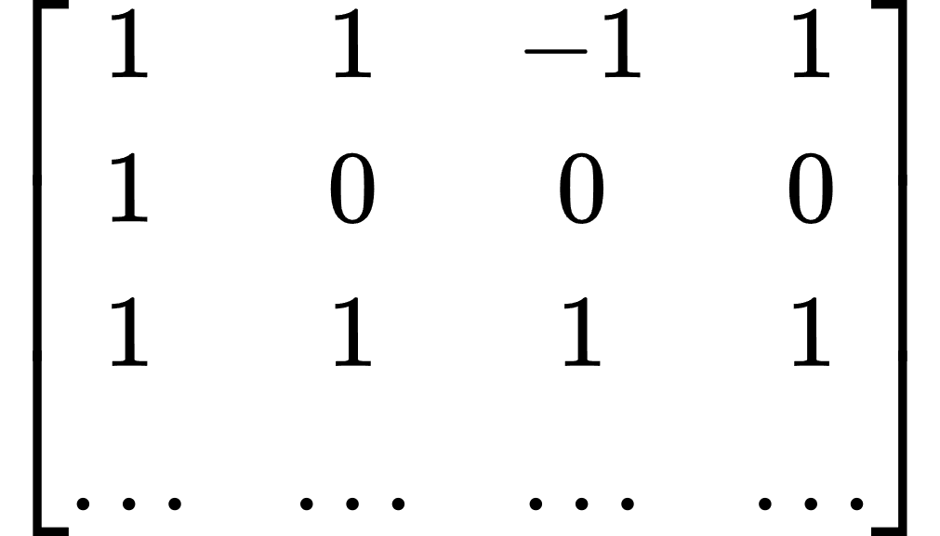
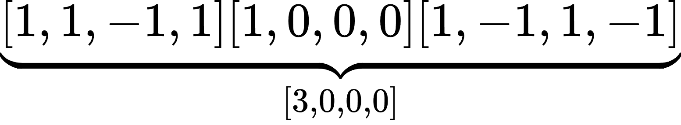
Table generation and SET evaluation
Tables are algorithmically represented as matrices
Number of attributes
The rows represent the cards, and the columns the attributes
[Color, Shape, Shading, Number]
Each flavor is assigned the value of -1,0, or 1
Number of cards, attributes and tables are all parameters, and all rows are unique
Number of cards
SETs found by summing attribute by attribute for three cards, permuting on all 3-card combinations O(N³)*
Same flavors will add up to -3, 0, or 3
Different flavors will add up to 0
If the sum of the columns is any other value, the cards do not form a SET, and the combination is skipped
Flavors
*This is considering a brute-force approach, which we were able to optimize

Slide 5
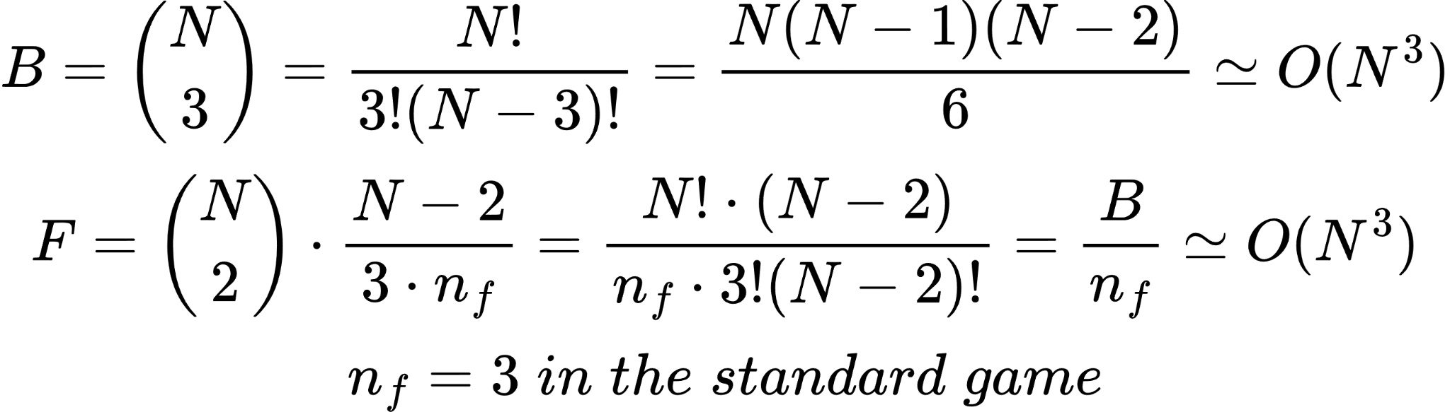
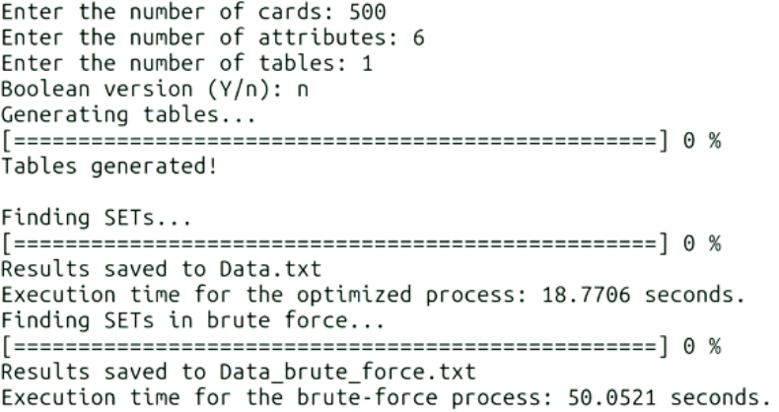
Our search algorithm
Wanted to avoid brute-force search
O(N³) complexity
Faster algorithm designed:
Sort the whole table once
Choose two rows combinatorially, pick the third so that the first elements add up to -3,0, or 3
Check the rest of the vector, stopping if the sum value is different than -3,0,3 for a column
Reduces by about a factor 3
Unfortunately process cannot be easily divided into separate cores
Always need to permute over the entire table to check for the “different” flavors case

Slide 6
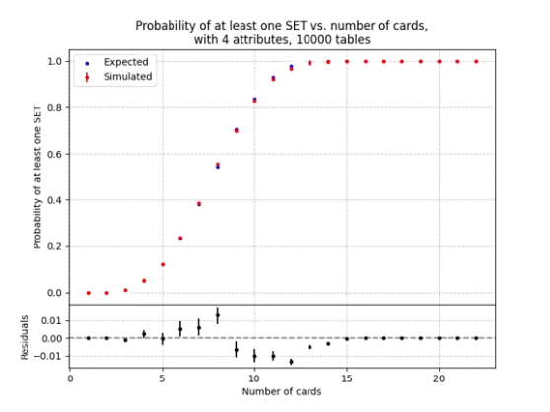
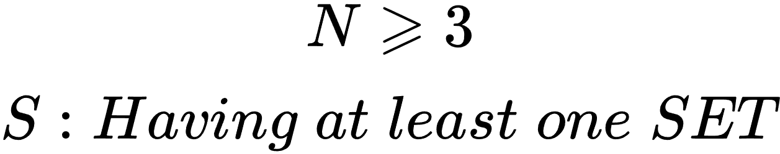
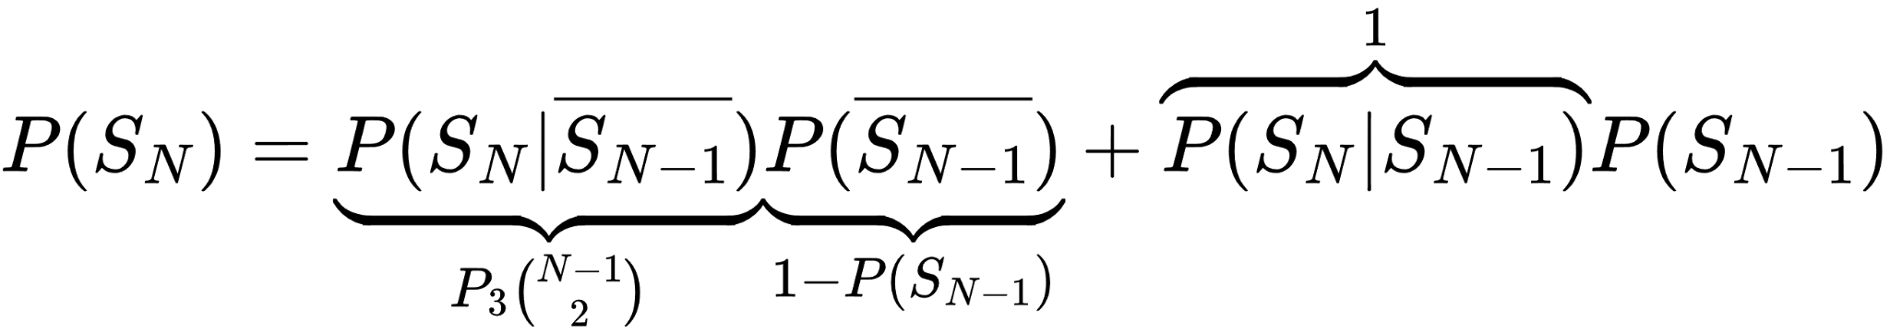
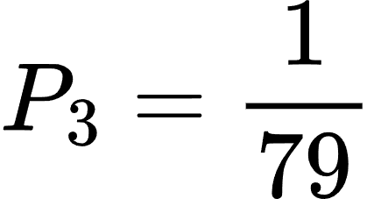
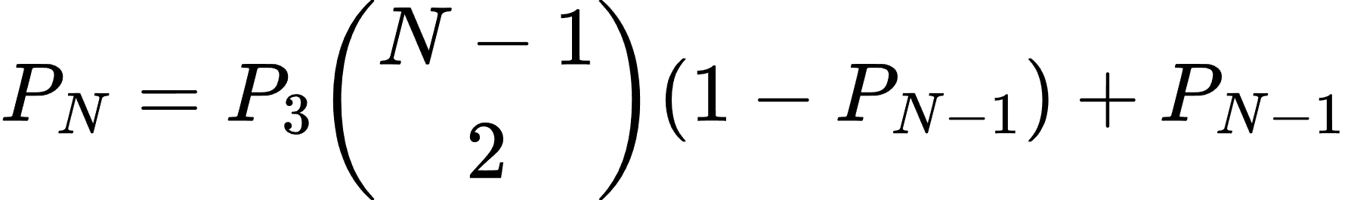
The idea:
In a standard 12-card table, there is no guarantee that a SET is present
How does the probability of having at least one SET change with the number of cards?
Rule: Given two cards only one card exists to complete a SET
Considering N cards out of 81 different cards:
Recursive succession brings us P_{N} given P_{N-1}
We can use our algorithm iteratively changing N to verify:
Good approximation, but not perfect!
Need to account that conditioning to N-1 cards with no SETs changes the probability of forming a new SET

Slide 7
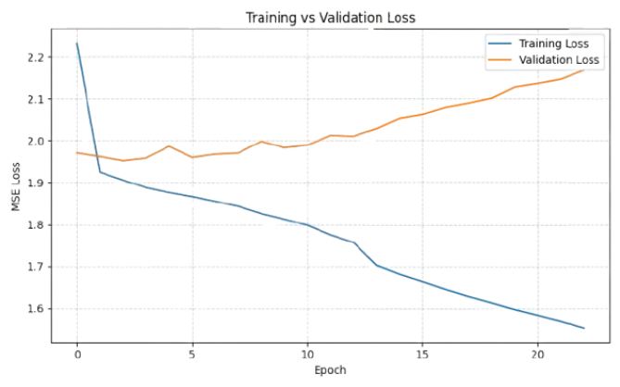
Neural network architecture
Are SETs countable?
Original idea: train a DNN to count the number of sets in a 12x4 table
Generate many (10⁶) tables and use cross-validation to train and validate
12x4 table + 1 integer as input, 1 float as output
Adam optimizer, MSE loss
Callbacks to prevent overfitting
Fundamentally not working, loss and validation loss remain high, no matter the changes
Average result using a CNN/DNN on 12-card tables, experimenting with various architectures

Slide 8
Why are Neural Networks so bad at counting?
Vastly different tables often bring to the same results
Such as row permutations
Possible solution: one-hot encoding for the flavors
So “color” would be represented by 3 floats between 0 and 1 that express the “amount of green, purple, red”, not one integer
Very similar tables bring vastly different results
One singular digit is enough to increase or decrease the number of SETs by an integer value
Each attribute would be structured like a 3x1 vector
Color: [0,1,0] = purple
NN’s are optimized for gradient-based learning, not discrete processes like counting
By construction this task is inherently not continuous nor differentiable
Must simplify the problem or propose another type of architecture
Each attribute would be represented by a 3x1 vector, and thus a card is described 12 parameters, instead of 4
CNN that convolutes on each attribute within a card, then over the whole table
Potentially easier for the NN, but requires changing the whole architecture, may not work

Slide 9
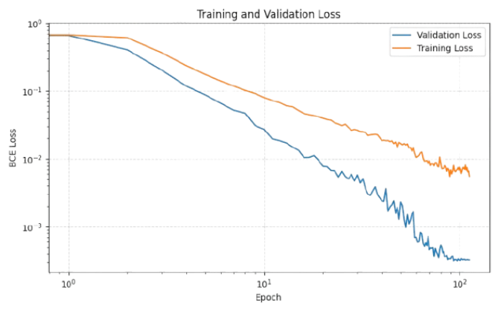
Single-SET identification
New idea: 3-card tables and check for at least one SET
Algorithm now stops at the first SET found
Counteracts NN counting problem
CNN with Binary cross-entropy loss
Normalized and smaller inputs
Problem: Not having a SET in 3 cards is much more probable than having one (1:79)
Permute rows 6x when a SET is present, and discard a fraction of SET-less tables
Even out the dataset
Much better results, DNN that can efficiently detect SETs!
On average 0.54 seconds to identify SETs in 10,000 tables O(N) with a mean 99.96% success rate
31.8 seconds with the optimized algorithm O(N³)

Slide 10
Thank you for your attention!
Works Cited
Bolognese, Chris. “The Mathematical Beauty of the Game SET.” The Aperiodical, 22 July 2018, aperiodical.com/2018/07/the-mathematical-beauty-of-the-game-set/.
Chaudhuri, Kamalika, et al. ON the COMPLEXITY of the GAME of SET. 9 Jan. 2022.
Katz, Alexander. “Set (Game) | Brilliant Math & Science Wiki.” Brilliant.org, 2016, brilliant.org/wiki/set-game/.
Knuth, Donald. Stanford.edu, 2020, www-cs-faculty.stanford.edu/~knuth/programs/setset-all.w. Accessed 7 Apr. 2025.
Lent, Benjamin, et al. THE CARD GAME SET. 5 June 2013.
Warne, Henrik. “SET® Probabilities Revisited.” Henrik Warne’s Blog, 30 Sept. 2011, henrikwarne.com/2011/09/30/set-probabilities-revisited/.
Questions?

